Slide 1
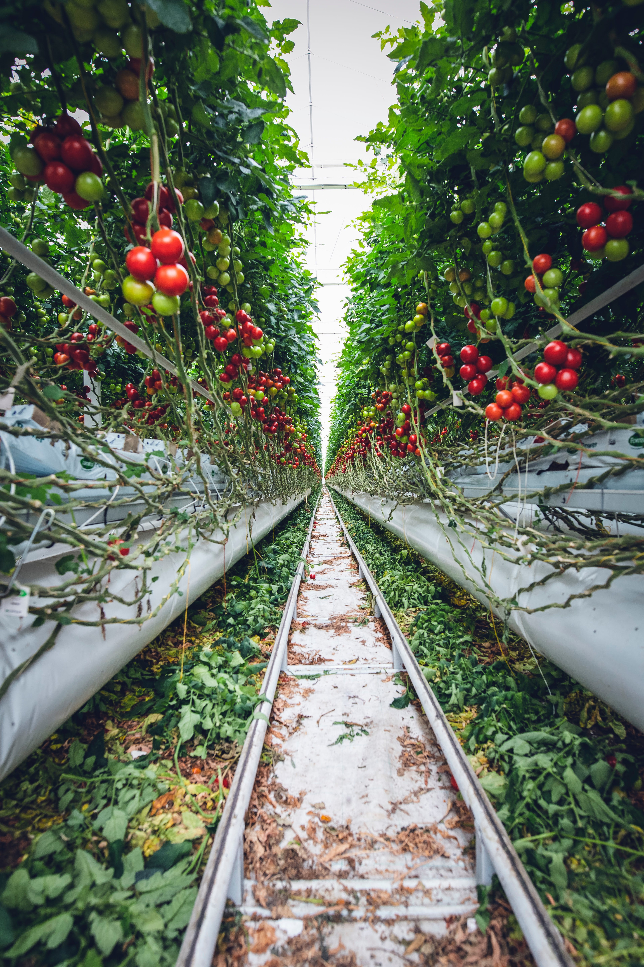
POTATO LEAF DISEASE DETECTION DL MODEL
DATA COLLECTION | MODEL BUILDING | WEB PAGE | GCP EMULATOR APP

Slide 2


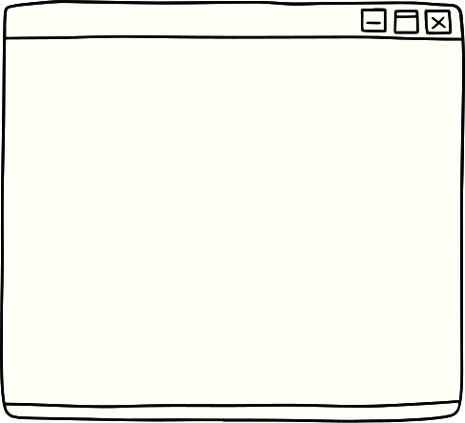



Problem Statement
POTATO LEAF DISEASES SUCH AS EARLY AND LATE BLIGHT CAUSE SIGNIFICANT ECONOMIC LOSSES FOR FARMERS AROUND THE WORLD. TO ADDRESS THIS PROBLEM, THE PROJECT AIMS TO HARNESS INNOVATIVE TECHNOLOGY TO DEVELOP EFFECTIVE AND SUSTAINABLE SOLUTIONS FOR POTATO DISEASE MANAGEMENT
USING DEEP LEARNING, THIS AGRO-TECH SOLUTION PREDICTS AND PREVENTS POTATO LEAF DISEASES, ENSURING CROP HEALTH AND FARMER PROSPERITY

Slide 3
Data Collection & Model Building
Dataset : Kaggle Dataset | Plant Village
Data Preprocessing | Resizing, Augmentation
Dataset Partitioning | Splitting for subsets
Model Architecture | CNN with ReLU
Model Compilation | Compile with settings.
Model Training | Train for learning
Model Evaluation | Assess model performance
Results Visualization | Display training results
Image Prediction | Make predictions on images
Model Export | Save the trained model
FAST API | Create a user interface
Load Trained Model | Load the saved model
Make Predictions | Use the model for predictions

Slide 4

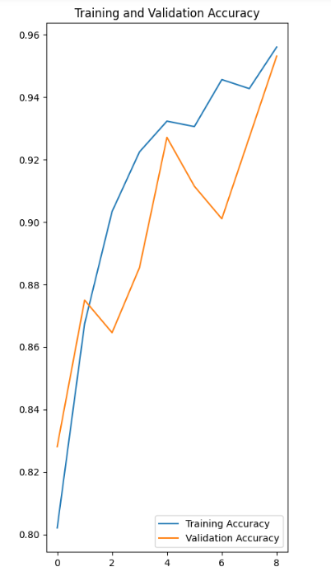
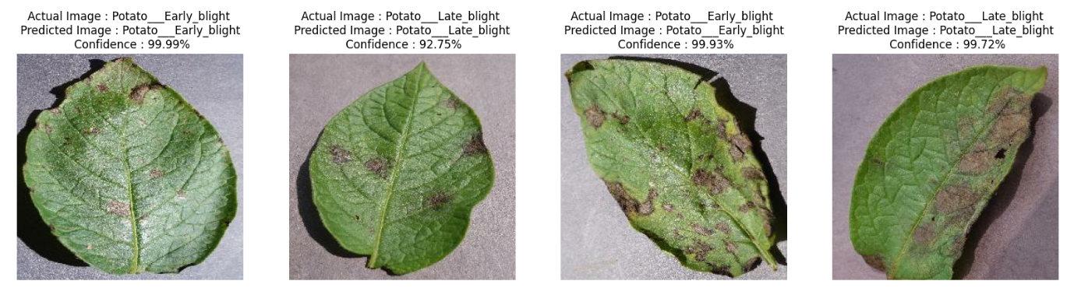
Training & Validation Accuracy
Model Prediction
CNN (Convolutional Neural Network) | Deep learning architecture for image processing.
ReLU (Rectified Linear Unit) | Activation function that introduces non-linearity.
Softmax | Activation function for multi-class classification.
Data Augmentation | Expands training data with image transformations.

Slide 5
Back End - FAST API
FastAPI for Building APIs
FastAPI is a Python web framework designed for building APIs quickly and efficiently. It allows developers to create RESTful web services with minimal code while maintaining high performance.
Automatic Data Validation
FastAPI provides automatic data validation and serialization, reducing the risk of common API errors. It uses Python-type hints to validate incoming data and generate accurate API documentation.
Async Support
FastAPI fully supports asynchronous programming, making it suitable for handling concurrent requests and I/O-bound operations. This feature enhances the scalability and responsiveness of web applications built with FastAPI.

Slide 6

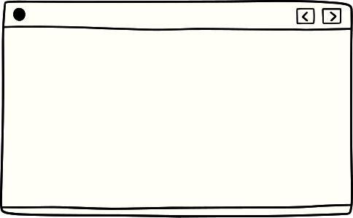

Front End React
Material-UI for UI Components
The script employs Material-UI, a UI framework for React, integrating components like AppBar, Toolbar, and Card to create a modern and visually appealing user interface.
Image Processing with Axios
It utilizes Axios, a promise-based HTTP client, to send image data to a local server for image classification, showcasing an asynchronous approach to handling data.
Responsive Design Principles
The script follows responsive design principles, ensuring the web application's adaptability to various screen sizes, enhancing user experience across devices.
State Management with useState
React's useState hook manages component state, enabling dynamic updates of image data, previews, and loading indicators as users interact with the application.

Slide 7
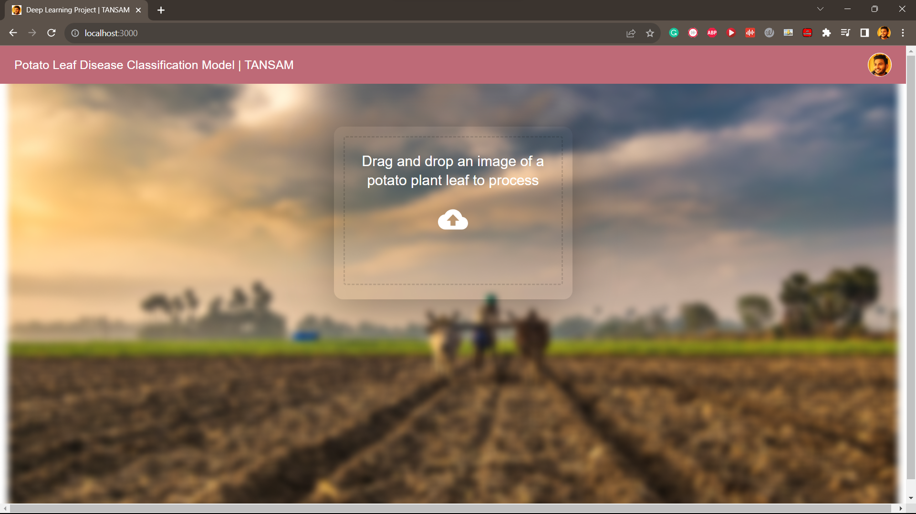
FRONT END REACT UI

Slide 8
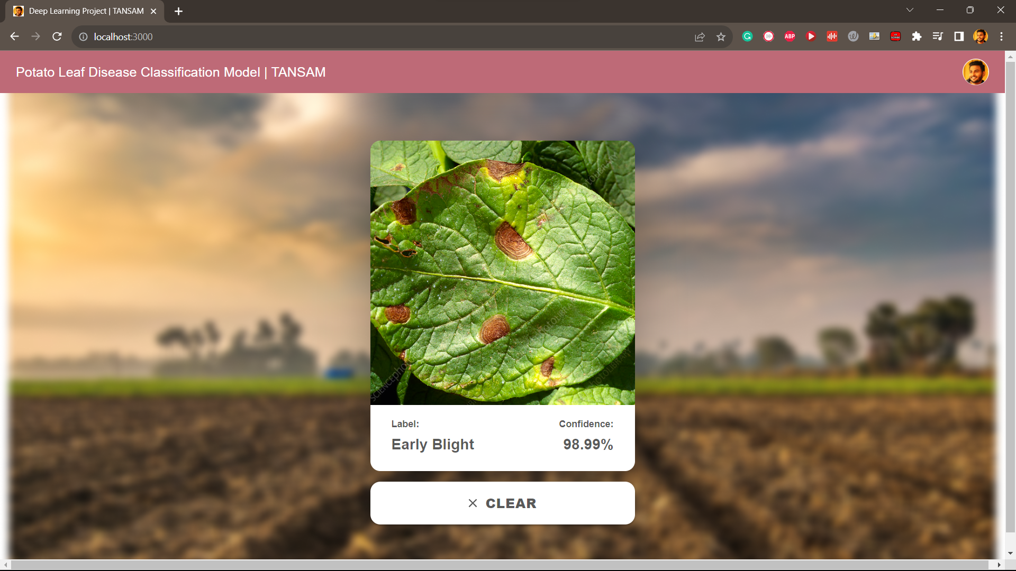
SAMPLE : EARLY BLIGHT DISEASE AFFECTED LEAF
CONFIDENCE PERCENTAGE OF 98.99% RETURNED
MODEL PREDICTION IS GOOD

Slide 9
GCP Cluod Deployemnt & Testing
Project ID | GCP Bucket | .h5 Model
GCP | Google Cloud Platform | Setting up the environment
Started creating a GCP account and project, setting up a unique bucket for model storage, and installing the Google Cloud SDK.
Code Development
A Python script for a cloud function that downloads the pre-trained ML model, preprocesses input images and performs predictions using TensorFlow/Keras.
Deployment
Deployed the cloud function using the Google Cloud SDK, ensuring necessary libraries were included, and enabled the Google Cloud API whenever prompted.
Testing
Used Postman to send image data as form data to the deployed function, that analyze the response for predictions, and ensures the function works correctly.
Function & URL
predict & https://us-central1-leaf-disease-classification-1.cloudfunctions.net/predict

Slide 10

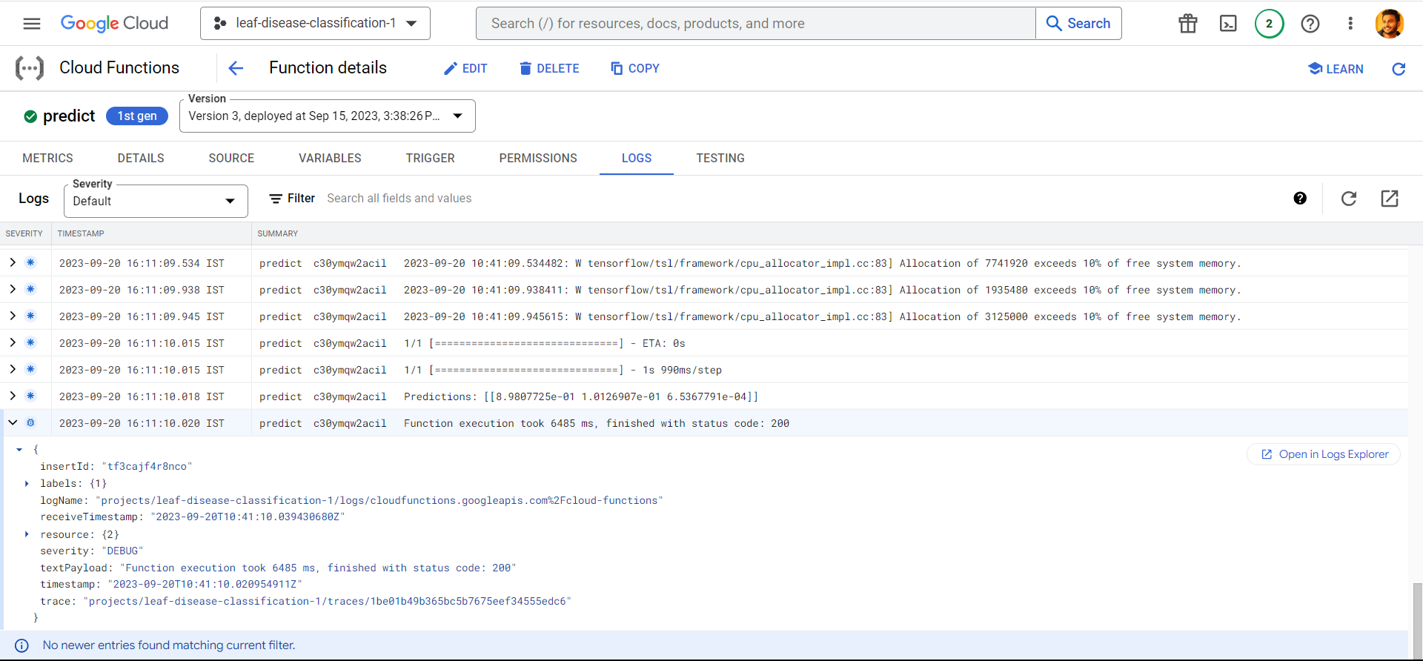
GCP Deployment

Slide 11
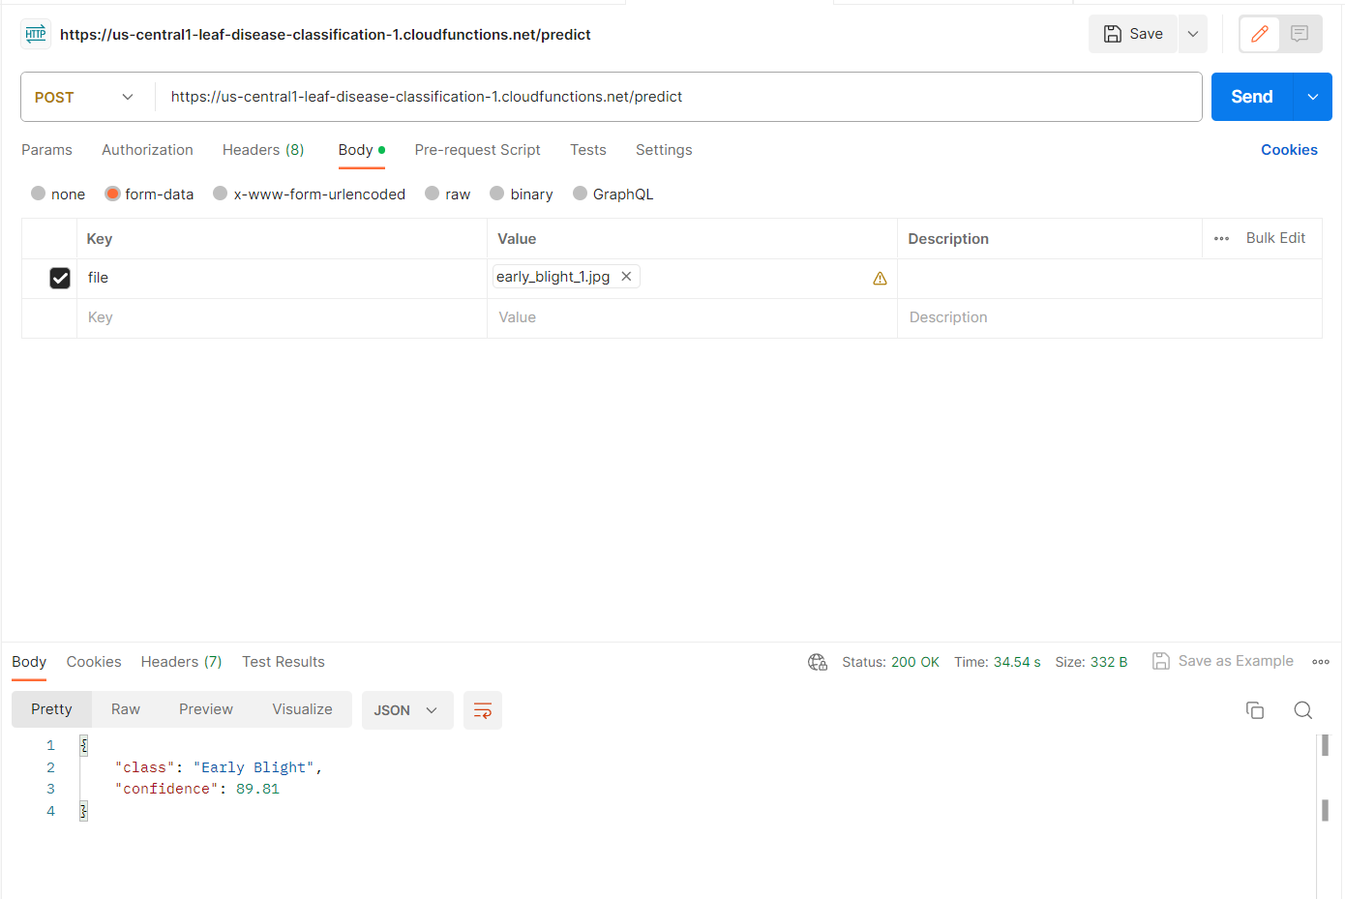
Postman Invoke

Slide 12
Mobile App Deployment
React Native Setup
Prepared the development environment by installing the necessary tools and dependencies for React Native, ensuring the platform-specific instructions.
Configuring Mobile App
Cloned the mobile app repository from GitHub, configure environment variables (like the Google Cloud Functions link), and install required Node.js modules using "yarn install."
Emulator Setup
Created a virtual Android device using Android Studio's AVD Manager (for Windows users) and ran
the emulator.
Mobile App Testing
Launched the React Native mobile app on the emulator, which will communicate with the deployed Google Cloud Function for image prediction, enabling real-time testing and interaction.

Slide 13
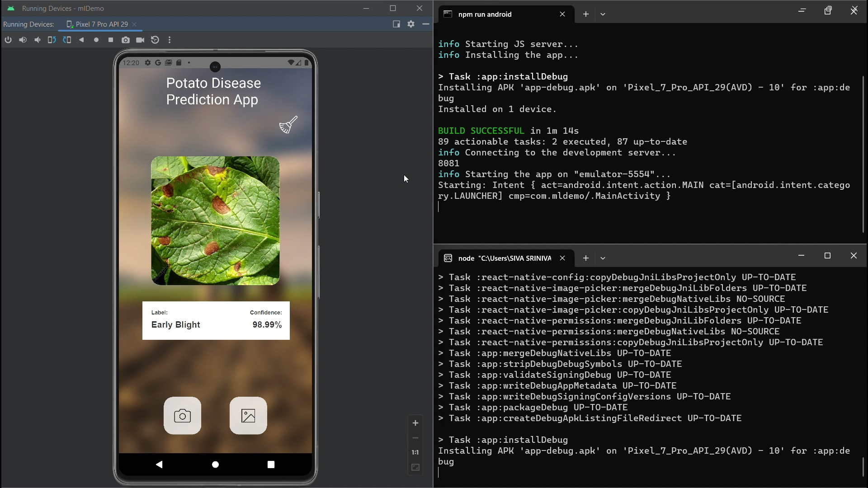
MOBILE
APP
DEPLOYMENT
IN
ANDROID
EMULATOR

Slide 14







Data Prep: Gather, clean, label, and preprocess a diverse leaf image dataset.
Model Design: Craft a CNN architecture with convolutional and pooling layers.
Hyperparameter Tuning: Fine-tune settings like learning rate and batch size.
Transfer Learning: Leverage pre-trained CNN models and adapt them.
Loss & Metrics: Define appropriate loss functions and evaluation metrics.
Regularization: Combat overfitting with dropout and L2 regularization.
Optimizers: Choose optimizers and learning rate strategies.
Deployment: Scale, optimize, and integrate the model into applications.
Monitoring: Continuously assess model performance in production.
Interpretability: Employ techniques to explain model decisions, enhancing the trust
Data Collection - Preprocessing -
Cleansing
Model Building using CNN
FAST API
POST
MAN
REACT
NATIVE
GCP

Slide 15






I am so grateful for the opportunity and your faith on me
Willing to furnish my finest on this endeavor
Resources Involved
Android Studio | Postman | React | React Native | Jupyter Notebook | PyCharm Microsoft Visual Studio Code | Chatgpt
Youtube Tutorials
"In the process of working on this project, I've had the opportunity to gather valuable insights from
Chat GPT and various web and YouTube tutorials.
These resources have played a crucial role in shaping my approach.
It's worth mentioning that I come from a non-CS background, so I've actively sought out tutorials and received support from
Chat GPT to navigate areas like front-end, back-end, API, and GCP. It's been a great learning journey.

